Slide 1
Dual Axis Solar Tracker Using Arduino

Slide 2
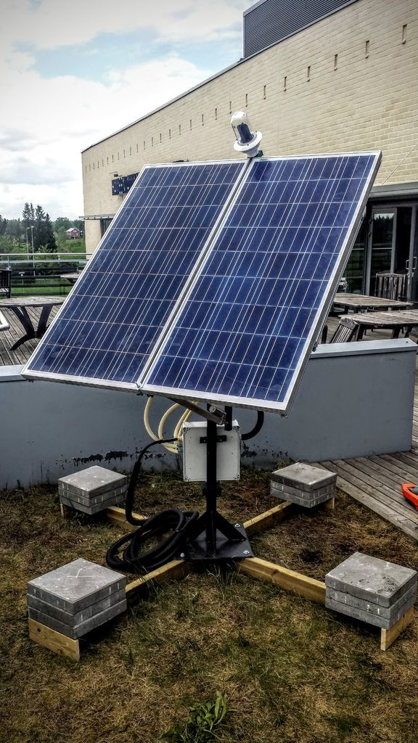
Introduction to Dual Axis Solar Tracker
A dual axis solar tracker is a device that follows the movement of the sun in both the horizontal and vertical axis.
It optimizes the solar panel's position to maximize the amount of sunlight it receives throughout the day.
Arduino parts like servos, stepper motors, solar panels, and frames are essential components of a dual axis solar tracker.
1
Notes:
Image source: https://pic-microcontroller.com/dual-axis-solar-tracker-online-energy-monitor/

Slide 3
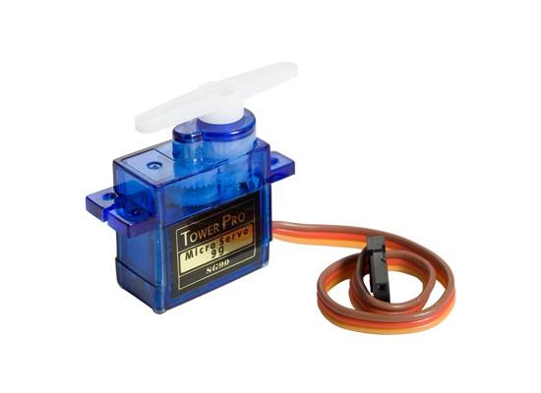
Servo Motor
A servo motor is a compact device that provides precise control of angular or linear position.
It is commonly used in dual axis solar trackers to move the solar panel in the horizontal axis.
The servo motor receives signals from the arduino board and adjusts the position of the solar panel accordingly.
2
Notes:
Image source: https://makerobotbangalore.blogspot.com/p/servo-motor-interfacing-with-arduino.html

Slide 4
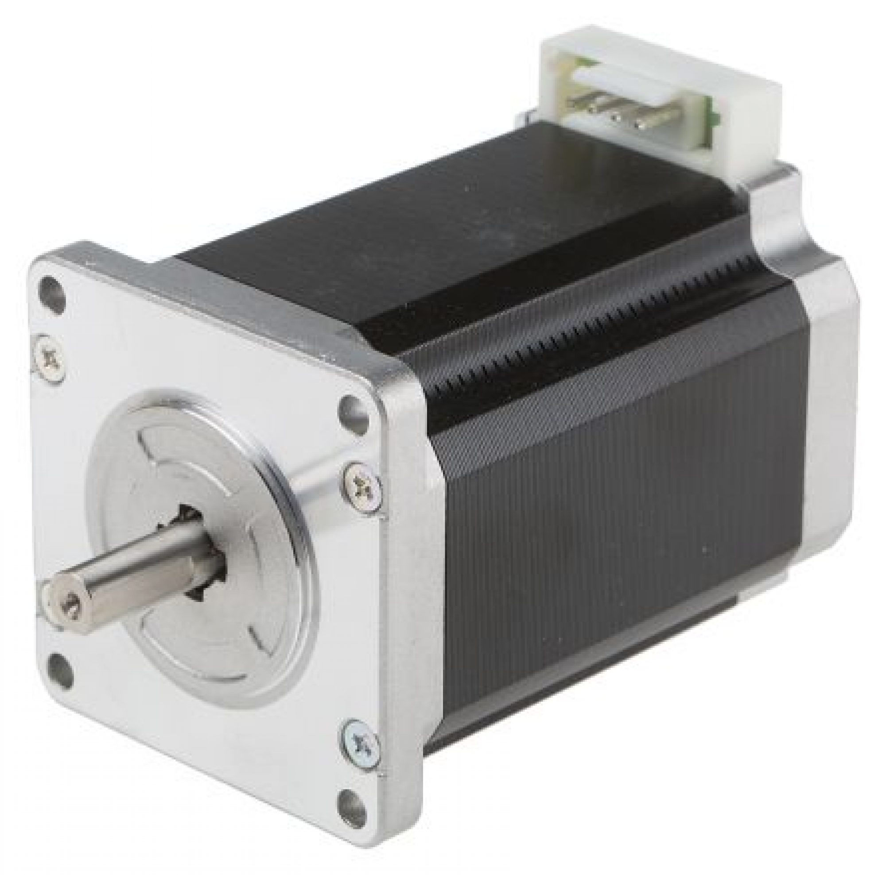
Stepper Motor
A stepper motor is a brushless DC electric motor that divides a full rotation into a number of equal steps.
It is used in dual axis solar trackers to move the solar panel in the vertical axis.
The stepper motor receives signals from the arduino board and rotates in small increments to align the solar panel with the sun.
3
Notes:
Image source: https://www.majju.pk/product/stepper-motor-with-driver-24v-4a/

Slide 5
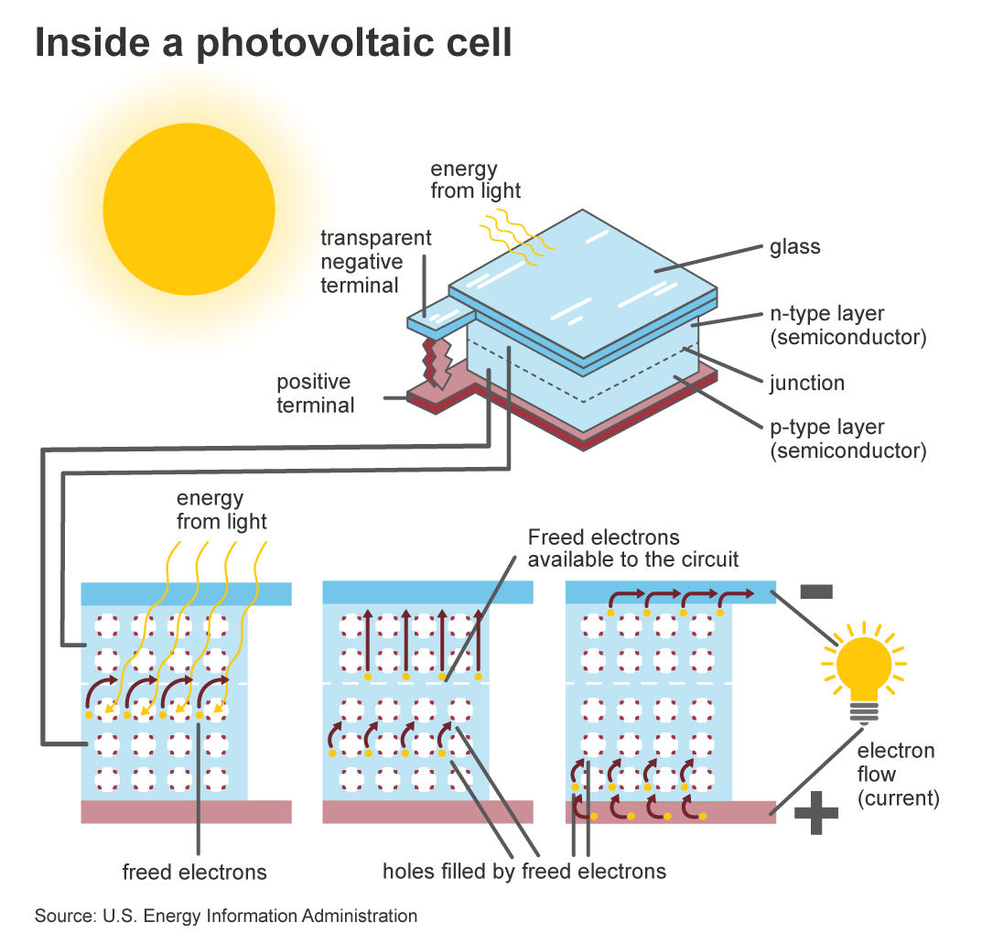
Solar Panel
A solar panel is a device that converts sunlight into electrical energy.
It is the main component of a dual axis solar tracker, as it is responsible for capturing sunlight.
The solar panel is mounted on the frame and moves according to the signals received from the servo and stepper motors.
4
Notes:
Image source: https://www.brijencapsulants.com/2020/12/28/six-main-components-solar-panel/

Slide 6
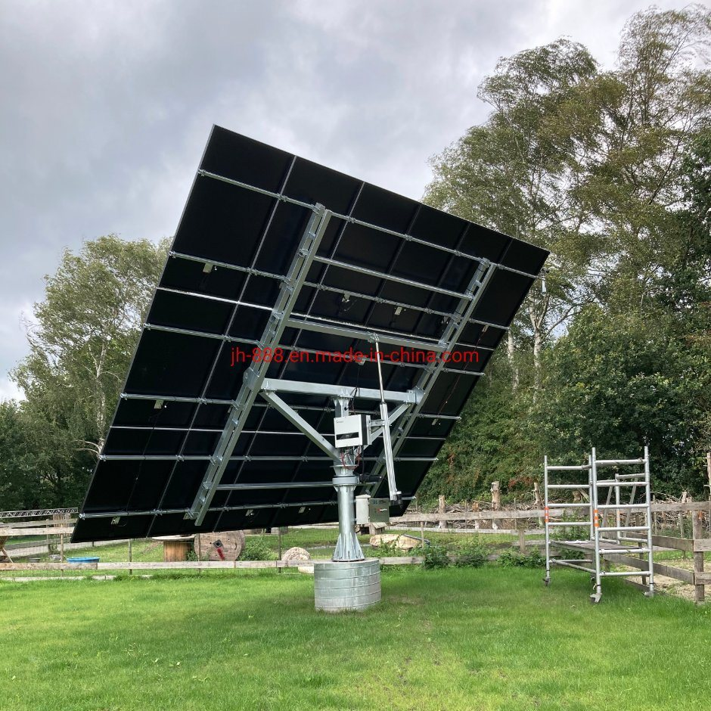
Frame
The frame of a dual axis solar tracker provides structural support to the solar panel and other components.
It is usually made of durable materials like aluminum or steel to withstand outdoor conditions.
The frame is designed to allow smooth movement of the solar panel in both the horizontal and vertical axis.
5
Notes:
Image source: https://jh-888.en.made-in-china.com/product/BKinfJCAgNpW/China-5500W-Dual-Axis-Solar-Tracker-Trace-Sun-Energy.html

Slide 7
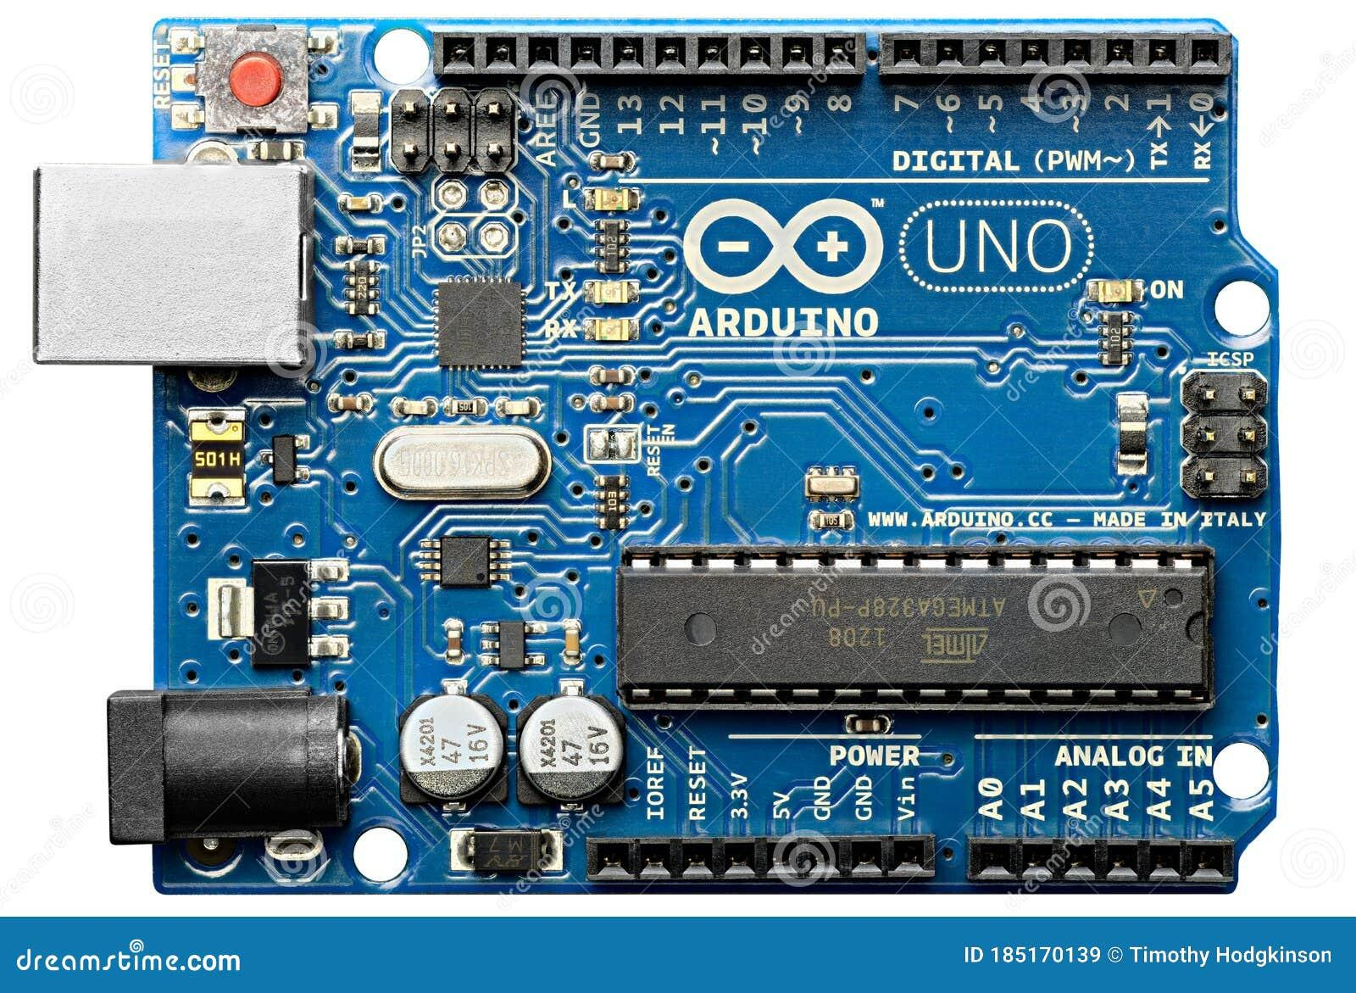
Arduino Board
An Arduino board is a microcontroller-based platform used to control various electronic components in a project.
It acts as the brain of a dual axis solar tracker, sending signals to the servo and stepper motors.
Arduino boards are programmable, allowing customization of the solar tracker's behavior based on specific parameters and requirements.
6
Notes:
Image source: https://cartoondealer.com/image/98471627/arduino-uno-microcontroller.html

Slide 8
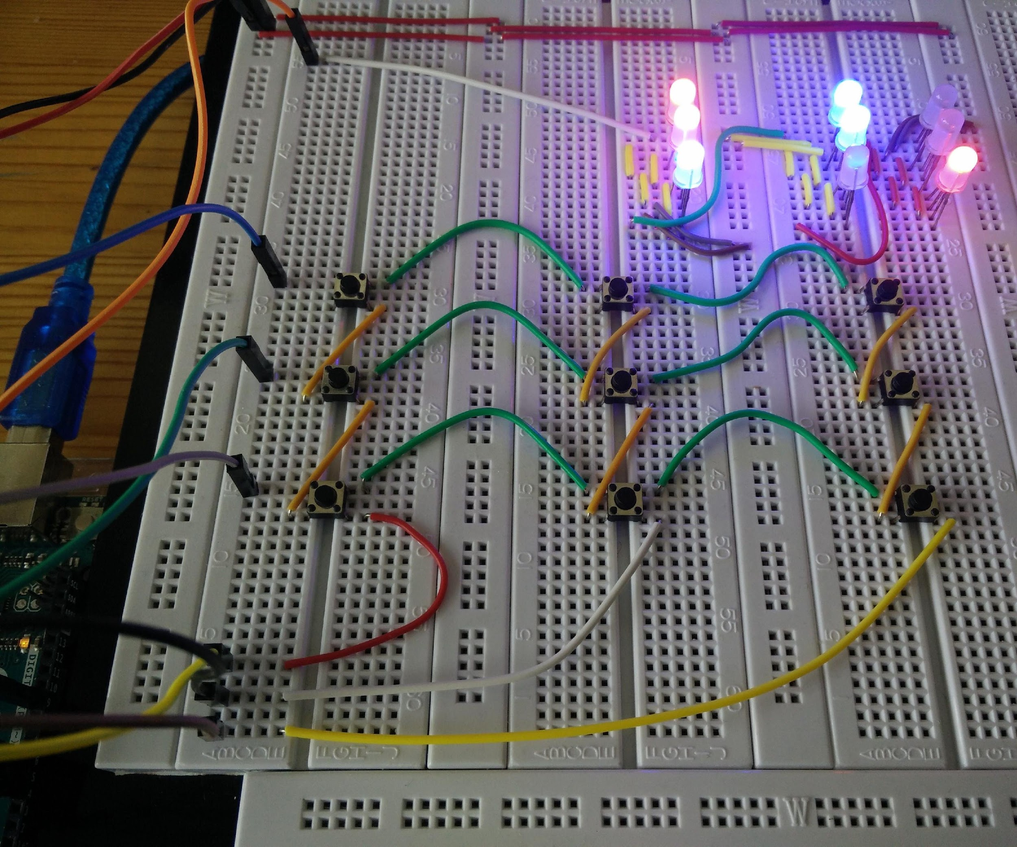
Control Algorithm
The control algorithm implemented in the Arduino board determines the movement of the solar panel.
It uses input from sensors or calculations based on time and location to track the sun's position.
The algorithm calculates the necessary angles for the servo and stepper motors to align the solar panel with the sun.
7
Notes:
Image source: https://www.instructables.com/Tic-Tac-Toe-on-Arduino-With-AI-Minimax-Algorithm/

Slide 9
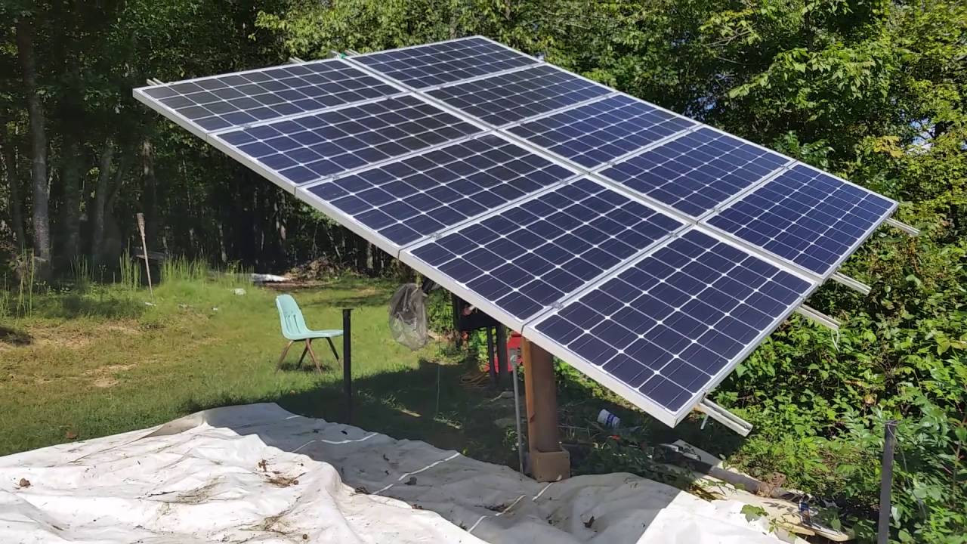
Benefits of Dual Axis Solar Tracker
Dual axis solar trackers increase the overall efficiency of solar panels by up to 40% compared to fixed installations.
They maximize the capture of solar energy throughout the day by continuously adjusting the panel's position.
Dual axis solar trackers are particularly beneficial in regions with high solar incidence and variable weather conditions.
8
Notes:
Image source: https://diymanualz.blogspot.com/2023/05/dual-axis-solar-tracker-diy.html

Slide 10
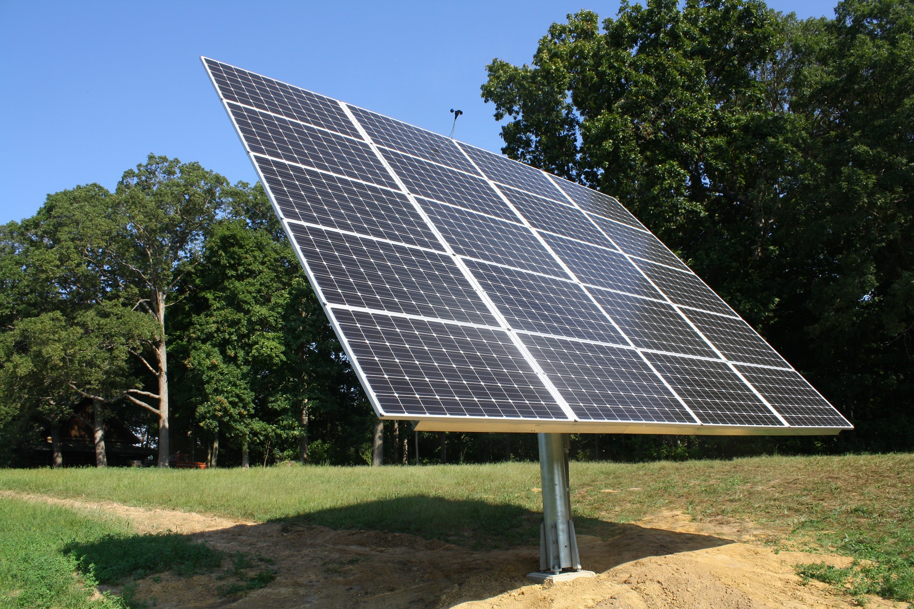
Applications of Dual Axis Solar Tracker
Dual axis solar trackers are commonly used in residential and commercial solar energy systems.
They are also employed in agricultural applications, such as powering irrigation systems or providing energy for farms.
The technology is continuously evolving, with potential applications in space exploration and satellite tracking.
9
Notes:
Image source: https://www.ticktockenergy.com/solar-energy-systems/img_7270/

Slide 11
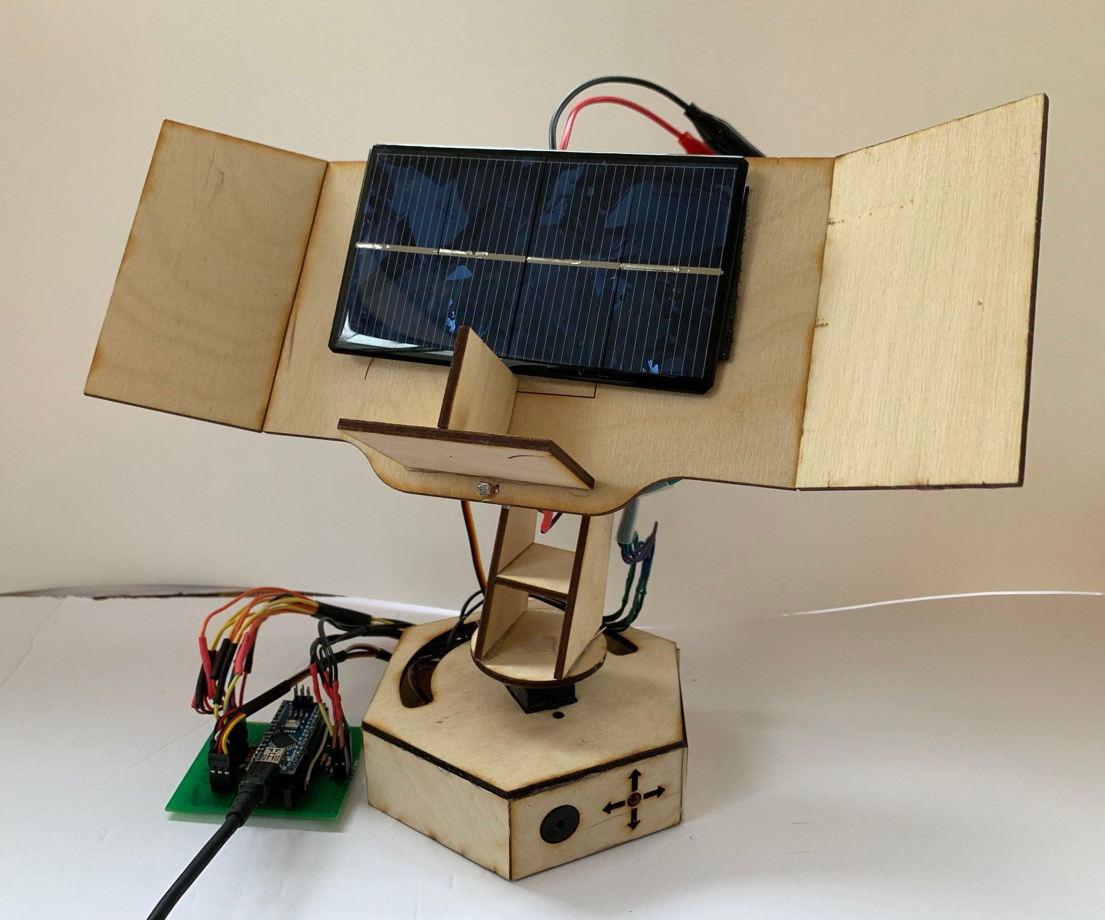
Conclusion
Dual axis solar trackers, utilizing arduino parts like servos, stepper motors, solar panels, and frames, enhance the efficiency of solar energy systems.
By continuously adjusting the position of the solar panel, they maximize the capture of sunlight throughout the day.
These trackers have numerous applications in various industries and hold great potential for future advancements in solar energy technology.
10
Notes:
Image source: https://www.instructables.com/id/Building-an-Automatic-Solar-Tracker-With-Arduino-N/

